Slide 1
Service Fabric: A Platform for Building and Managing Highly Scalable Services
Shawn Weisfeld
shawn@shawnweisfeld.com
http://www.shawnweisfeld.com

Slide 2







About Me
Founder of UserGroup.tv
Technical Evangelist at Microsoft

Slide 3


Watch User Group presentations for FREE online!
All the topics you care about
Including:
Agile
C#
Entity Framework
HTML5
MVC
Silverlight
XAML
jQuery
and Much More!
Miss a User Group meeting?
Forget something that you learned?
Want to see content from a User Group not in your area?
Want to share with a buddy?
We know you cannot make it to every User Group meeting,
that is why we post them online for you!
We now have over 425 presentations online
That is over 100 GB of video
New Content added all the time!
Presentations from the thought leaders on the topic.
For new content announcements
@UserGroupTV
http://www.UserGroup.tv

Slide 4
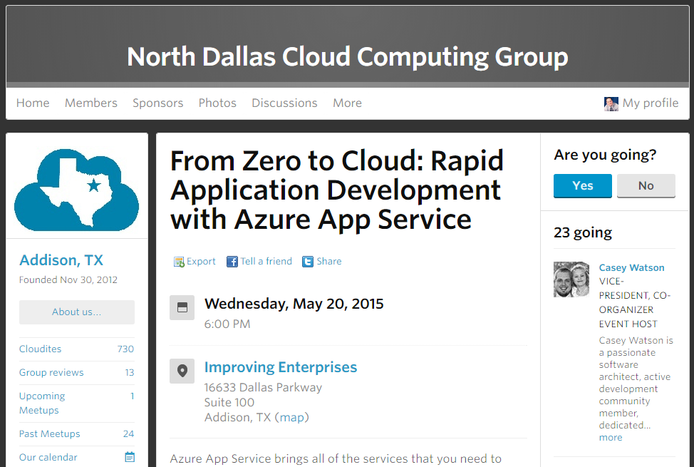
North Dallas Cloud
http://www.northdallascloud.com

Slide 5
Demos
Stateless Pi Service
Stateful Pi Service
Hello World Actor Service

Slide 6
Agenda
Azure Service Fabric platform
Applications and microservices
Programming models
Scaling
Management

Slide 7
Service Fabric at //build
2-700: Building Resilient, Scalable Services with Microsoft Azure Service Fabric
Mark Fussell - Principal Program Manager
Vipul Modi - Principal Software Engineering Manager
2-640: Microsoft Azure Service Fabric Architecture
Gopal Kakivaya - Corporate Vice President
2-717: Deploying and Managing Services with Service Fabric
Chacko Daniel - Principal Program Manager
2-66: Deep Dive into Microsoft Azure Service Fabric Reliable Actors
Claudio Caldato - Principal Program Manager

Slide 8
Application development in the age of the Cloud
Features
Scalability
Availability
Latency
Lifecycle
Data Integrity
Portability
Manage Services
Deliver Features Faster
Create Business Value

Slide 9
Cloud Service Architectures
Features
traditional
Scalability
Microservices
User Interface
Availability
User Interface
Business Logic
Data
Latency
Business Logic
Lifecycle
Data Integrity
Data
Portability
Manage Services
Deliver Features Faster
Create Business Value

Slide 10
Battle-hardened for over 5 years
Skype for Business
Hybrid Ops
Azure Document DB
billions transactions/week
Intune
800k devices
Azure Core Infrastructure
thousands of machines
Event Hubs
20bn events/day
Bing Cortana
500m evals/sec
Azure SQL Database
1.4 million databases
Power BI

Slide 11
Microsoft Azure Service Fabric A platform for reliable, hyperscale, microservice-based applications
Microservices
High Availability
Data Partitioning
Service Fabric
Health Monitoring
Container Orchestration & lifecycle management
Hybrid Operations
Self-healing
Simple programming models
High Density
Rolling Upgrades
Low Latency
Placement Constraints
Replication & Failover
Stateful services
Fast startup & shutdown
Load balancing
Hyper-Scale
Automated Rollback
Windows
Server
Linux
Windows
Server
Linux
Azure
Hosted Clouds
Windows
Server
Linux
Private Clouds

Slide 12

Service Fabric cluster with microservices
App1
App2

Slide 13
Handling machine failures
App1
App2

Slide 14
What is a microservice?
Is (logic + state) that is independently versioned, deployed, and scaled
Has a unique name that can be resolved
e.g. fabric:/myapplication/myservice
Interacts with other microservices over well defined interfaces and protocols like REST
Remains always logically consistent in the presence of failures
Hosted inside a “container” (code + config)
Can be written in any language and framework
node.js, Java VMs, any EXE
Developed by a small engineering team

Slide 15
Types of microservices
Stateless microservice
Has either no state or it can be retrieved from an external store
There can be N instances
e.g. web frontends, protocol gateways, Azure Cloud Services etc.
Stateful microservice
Maintain hard, authoritative state
N consistent copies achieved through replication and local persistence
e.g. database, documents, workflow, user profile, shopping cart etc.

Slide 16


What can you build with Service Fabric?
Stateless applications
A service that has state where the state is persisted to external storage, such as Azure databases or Azure storage
e.g. Existing web (ASP.NET) and worker role applications
Stateful applications
Reliability of state through replication and local persistence
Reduces latency
Reduces the complexity and number of components in traditional three tier architecture
Existing apps written with other frameworks
node.js, Java VMs, any EXE

Slide 17
Service Fabric Applications
Applications composed of microservices
Reliable Actors API
Reliable Services API
Service Fabric
Health Monitoring
Container Orchestration & lifecycle management
High Availability
Hybrid Operations
Data Partitioning
Self-healing
Simple programming models
High Density
Rolling Upgrades
Low Latency
Placement Constraints
Replication & Failover
Stateful services
Fast startup & shutdown
Load balancing
Hyper-Scale
Automated Rollback
Azure
Private Clouds

Slide 18
Reliable Actor API
Build reliable stateless and stateful objects with a virtual Actor Programming Model
Suitable for applications with multiple independent units of state and compute
Automatic state management and turn based concurrency (single threaded execution)

Slide 19
With Reliable Actors:
It easier to think about services as composed of smaller/independent/inter-connected entities.
Easy to get started: only 4 basic concepts to understand
Familiar design patterns
Code & State are reliable
It is designed to scale

Slide 20
Reliable Actors other features
Actors are ‘just’ objects
Pass them around
Exceptions are automatically propagated
GC:
The framework periodically scans for actors that have not been used for some period of time, and deactivates them. Once deactivated GC collects them.
GC frequency & Idle timeout can be customized at assembly and Actor type level
Timers & Reminders:
Useful to trigger recurring tasks on Actors
Reminders are not lost upon failures
Events:
Simple Pub/Sub model that Actors can use to send ‘messages’ to a client application/Web Frontend

Slide 21
DEMO – Hello World Actor Service

Slide 22
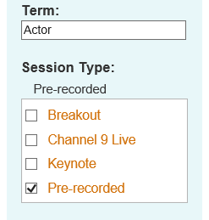
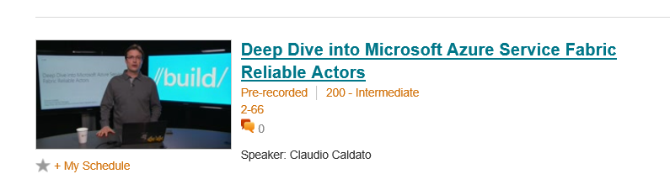
Learn more about Reliable Actors APIs
Watch pre-recorded session
http://channel9.msdn.com/Events/Build/2015/2-66

Slide 23





Defining applications and services
Code
Config
Application Type
Application
Package
Counter
Service type
Unit of
Lifetime
Versioning
Isolation
Counter WebApp type
Counter
Service
Pkg
Counter
WebApp
Pkg

Slide 24
Instantiating an application
app1
app2
Service
Package
A
Service
Package
A
Service
Package
B
Service
Package
B
app3
app4
Service
Package
A
Service
Package
A
Service
Package
B
Service
Package
B
ServiceType is “like” a .NET CLR type (class CounterServiceType)
ApplicationType is “like” a typed Container (CounterAppType : ServiceContainer<TServiceType> where TServiceType is CounterServiceType, ServiceType2
ApplicationInstance is an instance of the ApplicationType and has an unique name “fabric:/CounterApplication”
Each service instance has a unique name in the “namespace” of the application “fabric:/CounterApplication/CounterService”

Slide 25
Reliable Services API
Build stateless services using existing technologies such as ASP.NET
Build stateful services using reliable collections
Manage the concurrency and granularity of state changes using transactions
Communicate with services using the technology of your choice (e.g WebAPI, WCF)

Slide 26
Reliable Collections
Reliable collections make it easy to build stateful services.
Evolution of the .NET collections for the cloud
Collections
Single machine
Single threaded
Concurrent
Collections
Single machine
Multi threaded
Reliable Collections
Multi machine
Replicated (HA)
Persistence (durable)
Asynchronous
Transactional

Slide 27


Reliable Collections
IReliableDictionary<K,V>
IReliableQueue<T>
Atomically update one or more collections using transactions
Changes are replicated and durably stored on multiple replicas
Reads are repeatable within the transaction
Enumerations are snapshot based

Slide 28
DEMO
Reliable Service API Stateless Pi service

Slide 29






3-Tier service pattern
Load Balancer
Scale with partitioned storage
Increase reliability with queues
Reduce read latency with caches
Manage your own transactions for state consistency
Many moving parts each managed differently
Front End
(Stateless
Web)
Stateless
Middle-tier
Compute
Cache
Queues Storage

Slide 30

Stateful services: Simplify design, reduce latency
Application state lives in the compute tier
Low Latency reads and writes
Partitions are first class for scale-out
Built in transactions
Fewer moving parts
Load Balancer
Front End
(Stateless
Web)
Stateful
Middle-tier
Compute
data stores used for analytics and disaster recovery

Slide 31




Cloud Service vs Stateful Service Fabric
Cloud Services
Service Fabric
(Stateful)
Reliable Azure Queue
Azure Tables/NoSQL

Slide 32
DEMO
Reliable Service API Stateful PI service

Slide 33
Stateful microservices are reliable and consistent
Each service is backed by replica set to make its internal state reliable
All replicas are logically consistent – meaning all replicas see the same linearized order of read and write operations to initial state
Read-Write quorums are supported and are dynamically adjusted
Replica set is dynamically reconfigured to account for replica arrivals and departures

Slide 34
Stateful microservice
Application Package
replication
replication
S
S
P
S
S
P

Slide 35
Replication
Reads are completed at the primary
Writes are replicated to the write quorum of secondaries
Ack
Read
Value
Write
Ack
P
Ack
Ack
Ack
S
S
Write
Write
S
S
Write
Write

Slide 36
Reconfiguration
Types of reconfiguration
Primary failover
Removing a failed secondary
Adding recovered replica
Building a new secondary
Replica States
None
Idle Secondary
Active Secondary
Primary
X
Failed
P
S
P
B
S
S
X
Failed
S
S
Must be safe in the presence of cascading failures

Slide 37
Service partitioning
Services can be partitioned for scale-out
You can choose your own partitioning scheme
Service partitions are stripped across machine in the cluster
Node 100
Node 101
Node 102
Node 103
Node 104
Node 105
P1
P2
P3
S
S
S
S
S
S
P4
S
S
S
P
S
S

Slide 38




Scale-out and partitioning
Load Balancer

Slide 39
Application Lifecycle Management
Provisioning and deployment of constituent microservices
Upgrade microservices without loss of availability
Monitor microservices
Interface with machine management layer for autoscale and initiating reboot, reimage, and repair actions
Provide operational insight into aggregate utilization – inventory, performance counters/metrics, etc. – for capacity planning

Slide 40




Cluster: System view
System Services
Failover
manager
Cluster
manager
Naming
Image
store

Slide 41
Service Fabric management capabilities
Reliable optics into application health
Automatic repair action based on policies you set
Scales up/down based on service demand
Integrated alerting and notification system
Tools to effectively test a service for robustness
Tools for easy deployments and config management
Tools to perform service upgrades without downtime

Slide 42
Typical Datacenter
A set of machines (physical or virtual) with OS instances

Slide 43
Service Fabric Cluster
FD1/UD6
A set of nodes that Service Fabric stitches together to form a highly scalable cluster
Clusters are scalable
to 1000s of machines
Clusters can span Azure Regions
Node
FD0/UD0
FD1/UD5
Node
Node
FD0/UD1
FD2/UD4
Node
Node
FD2/UD3
Node

Slide 44
Instantiating an application
FD1/UD6
Node
FD0/UD0
FD1/UD5
Node
Node
FD0/UD1
FD2/UD4
Node
Node
app4
Service
Package
A
FD2/UD3
Node
1.0.0.0
Service
Package
B
ServiceType is like a .NET CLR type
Each service instance has a unique name in the “namespace” of the application “fabric:/Ticketing/SccheduleService”, “fabric:/Ticketing/InventoryService”, “fabric:/Ticketing/VoucherService”

Slide 45
Are you ready to deploy to Production ?
Security and Compliance
Role based access control
logs, traces retained per custom retention policies
Scale up and Scale out
Application Partitioning
Cluster Auto Scaling
Reliability and geo failover
#of partitions, # of replicas, isolation needs
Cluster Spanning regions.
Testability Service
Simulates real world failures
Health Monitoring and Diagnostics

Slide 46
State of the art Orchestration Engine
Specify custom constraints for resource balancing
Places services based on rules, load, Node capacities
Perform Optimizations
Allows services to dynamically adjust the consumptions and placement rules
Automatically rebalances the resources based on resource consumption and changes like addition/removal of services /Nodes

Slide 47
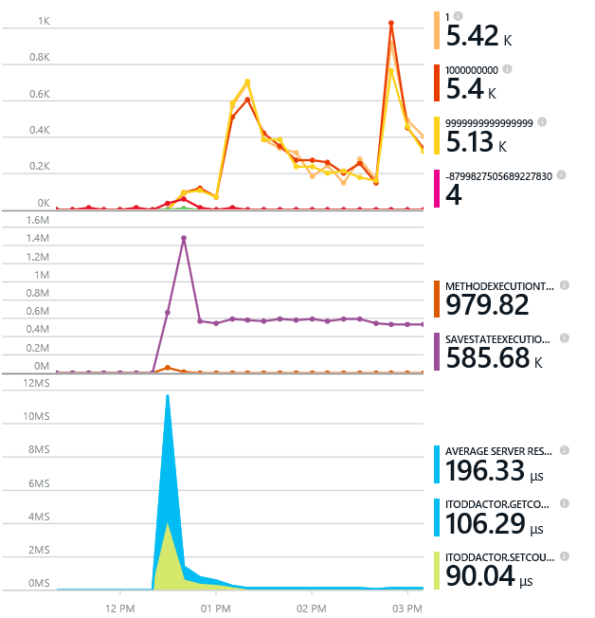
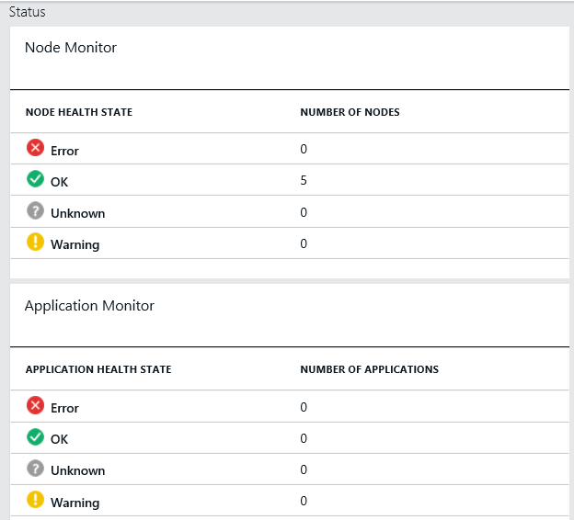
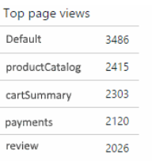
Monitoring your Services
Visibility into how your services are doing when running in production
Performance and stress response
Rich built-in metrics for Actors and Services programming models
Easy to add custom application performance metrics
Health status monitoring
Built-in health reports for cluster and system services
Flexible and extensible health store for custom app health reporting
Allows continuous monitoring for real-time alerting on problems in production
Business telemetry
Collect, analyze and drive insights from your customers’ interaction with your application
Allows data-driven decision making

Slide 48
Diagnostics and Troubleshooting
Detailed System Optics
Repair suggestions. Examples: Slow RunAsync cancellations, RunAsync failures
All important events logged. Examples: App creation, deploy and upgrade records. All Actor method calls.
Custom Application Tracing
ETW == Fast Industry Standard Logging Technology
Works across environments. Same code runs on devbox and also on production clusters on Azure.
Easy to add and system appends all the needed metadata such as node, app, service, and partition.
Choice of Tools
Visual Studio Diagnostics Events Viewer
Windows Event Viewer
Windows Azure Diagnostics + Operational Insights
Easy to plug in your preferred tools: Kibana, Elastisearch and more

Slide 49
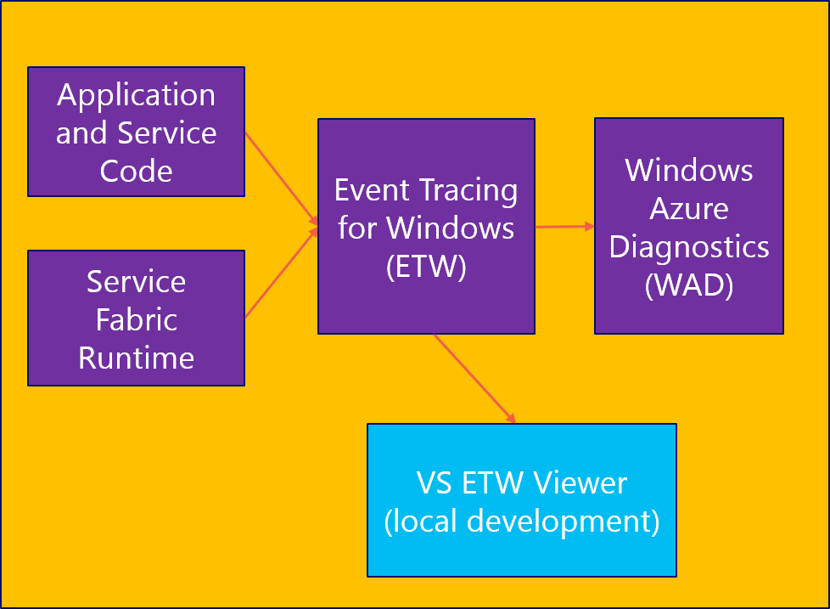
Diagnostics and Troubleshooting
Windows Machine
Application and Service Code
Operational Insights
Event Tracing for Windows (ETW)
Windows Azure Diagnostics (WAD)
Azure Table
Service Fabric Runtime
VS ETW Viewer (local development)

Slide 50
Azure Service Fabric
Rapidly develop microservice based applications
Operate reliable, scalable services
Enjoy the confidence of a battle-tested platform
Stateless or Stateful
Visual Studio tools
Focus on features not infrastructure
Rolling upgrades
Testability
Automatic Orchestration
Self-Healing
Comprehensive ALM
Health Monitoring
Diagnostics
The same technology Microsoft uses
Proven more than 5 years
Investment & Roadmap

Slide 51
Call to Action
Download the Service Fabric developer SDK
http://aka.ms/ServiceFabric
Learn from the tutorials and videos
http://aka.ms/ServiceFabricdocs
Provide feedback
http://aka.ms/ServiceFabricforum
http://stackoverflow.com/questions/tagged/azure-service-fabric

Slide 52
Thank you! Your Feedback is Important
Rate My Talk & Download Slides!
http://bit.ly/RateShawnsTalk
Contact Information
Email: shawn@shawnweisfeld.com
Blog: http://www.shawnweisfeld.com
Twitter: @shawnweisfeld

Slide 53

© 2014 Microsoft Corporation. All rights reserved. Microsoft, Windows, Windows Vista and other product names are or may be registered trademarks and/or trademarks in the U.S. and/or other countries.
The information herein is for informational purposes only and represents the current view of Microsoft Corporation as of the date of this presentation. Because Microsoft must respond to changing market conditions, it should not be interpreted to be a commitment on the part of Microsoft, and Microsoft cannot guarantee the accuracy of any information provided after the date of this presentation. MICROSOFT MAKES NO WARRANTIES, EXPRESS, IMPLIED OR STATUTORY, AS TO THE INFORMATION IN THIS PRESENTATION.

